Slide 1
Sentiment Analysis
Leader :Mr. Huynh Ba Thuy
Perform :Bui Quang Sang Ho Tan Viet

Slide 2
Introduce
Sentiment Analysis Scope
Types of Sentiment Analysis
Sentiment analysis is important ?
Sentiment Analysis Algorithms
Classification Algorithms
Sentiment Analysis Challenges

Slide 3
Introduce
Sentiment analysis is really an extension of text classification , you are provided with a cluster or a list of phrases and you must evaluate whether it is positive or negative
Every day in the world create 2.5 million million bytes of data, Sentiment analysis into a tool to understand its meaning, help the company to have an understanding of customers.

Slide 4
Introduce
It is an area in natural language processing (nlp) that builds and attempts to extract ideas in text. In addition it also extracts: Polarized (positive or negative), Subject, Comments holder
With the help of the emotional analysis system we can transform structured data about the idea of ​​bending them about products, services, brands, politics, ...

Slide 5
Sentiment Analysis Scope
Document level
Sentence level
Word level

Slide 6
Types of Sentiment Analysis
Fine grained Sentiment Analysis
Emotion detection
Aspect-based Sentiment (The weather sunny today)
Intent analysis (Your customer support is a disaster. I’ve been on hold for 20 minutes)
Multilingual sentiment analysis

Slide 7
Sentiment analysis is important ?
Scalability
Real time analysis
Consistent criteria

Slide 8
Sentiment Analysis Algorithms
Rule-based systems that perform sentiment analysis based on a set of manually crafted rules.
Automatic systems that rely on machine learning techniques to learn from data.
Hybrid systems that combine both rule based and automatic approaches.

Slide 9
Sentiment Analysis Algorithms
Rule-based(Own opinion)
Define two lists of polarized words
Given a text
Count the number of positive word that appear in the text
Count the number of negative words that appear in the text
If negative > positive => negative

Slide 10
Sentiment Analysis Algorithms
Step 1 : search the data set Step 2 :Clean the data Step 3:Trainning the data Step 4:input data to check Step 5:Check the result

Slide 11
Classification Algorithms
Naïve Bayes
Linear Regression
Support Vector Machines
Deep Learning

Slide 12
Sentiment Analysis Challenges
Subjectivity and Tone (The package is nice)
Context and Polarity (Absolutely nothing)
Irony and Sarcasm (Not one , but many)
Comparisons (This product is second to one)
Emojis
Defining Neutral

Slide 13
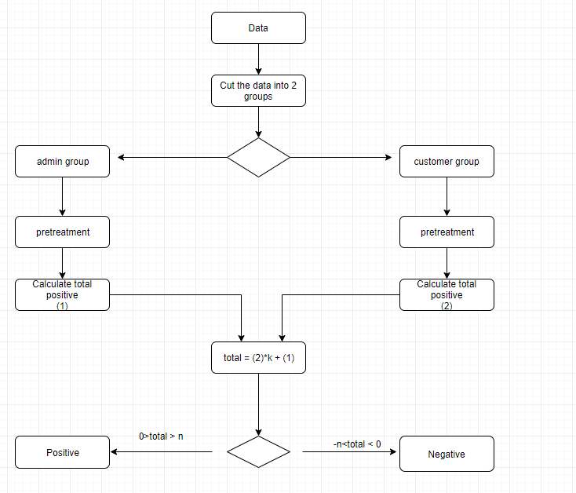
Diagram

Slide 14
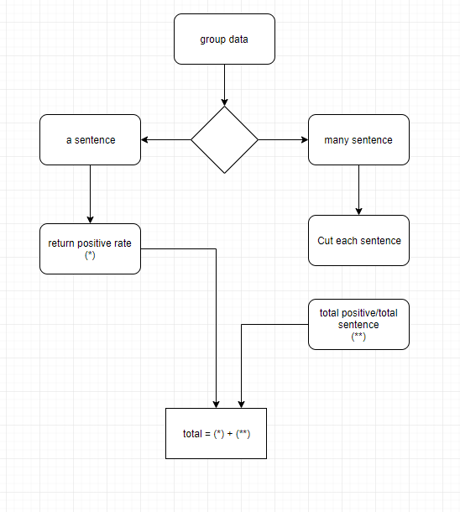
Diagram

Slide 15
Refer
1 https://monkeylearn.com/sentiment-analysis/
2 https://towardsdatascience.com/sentiment-analysis-using-lstm-step-by-step-50d074f09948

